Slide 1
NetFlix content

Slide 2

Agenda
Project goals
Dataset info
Tools
Descriptive statistical analysis
Trends analysis
Assumption and Questions
Insights
Summary and conclusions
Q&A

Slide 3
PROJECT GOALS
My main goals from this project is:
Clean or transform the data
Generate summary statistics
Create visualizations
Extract insights or trends

Slide 4

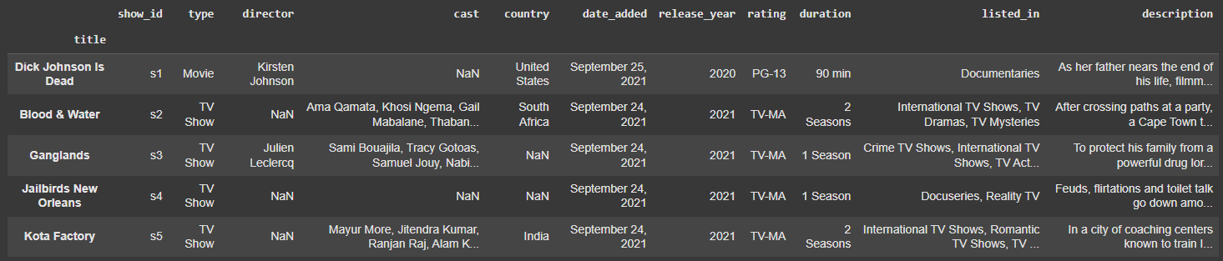
Dataset info
Netflix is one of the most popular media and video streaming platforms. They have over 8000 movies or tv shows available on their platform, as of mid-2021, they have over 200M Subscribers globally.
This tabular dataset consists of listings of all the movies and tv shows available on Netflix, along with details such as - cast, directors, ratings, release year, duration, etc.
Df.head(5)

Slide 5
Dataset info
Column | Description
show_id | Unique identifier for each show (e.g., s1, s2) – used internally by Netflix.
type | Specifies whether the content is a Movie or a TV Show.
title | Name of the show or movie.
director | Name(s) of the director(s). Many entries are missing (especially for TV shows).
cast | Main actors/actresses in the show or movie. This is a comma-separated list.
country | Country (or countries) where the content was produced.
date_added | The date the title was added to Netflix (e.g., "September 25, 2021").
release_year | The year the content was originally released.
rating | Age rating (e.g., "PG-13", "TV-MA") – indicates age suitability.
duration | For movies: duration in minutes (e.g., "90 min"); for TV shows: number of seasons (e.g., "2 Seasons").
listed_in | Genres or categories (e.g., "Documentaries", "TV Dramas", "International TV Shows").
description | A brief summary or synopsis of the content.
Structure of the DataFrame
Number of rows: 8,807
Number of columns: 12
Data types: Mostly strings (object), with one integer column (release_year)

Slide 6
Tools
In my project, I use advanced data analysis tools and libraries in Python, including:
Pandas – for processing, cleaning, and analyzing tabular data.
NumPy – for numerical and statistical computations.
Seaborn and Matplotlib – for visualizing data through statistical charts and trend plots.
Plotly Express – for creating interactive graphs that allow deeper data exploration.
Datetime – for handling and analyzing time-based data.
Using these tools, I present conclusions in a clear, visual, and intuitive manner, through graphs, tables, and interactive dashboards that highlight key insights from the data.

Slide 7
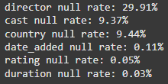
Data cleaning
Null rates
Replace blank countries with the mode (most common) country.
Replace NAN values with 'No Data' for director and cast.
Drop Null values
Converting date_added coloumn to datetime type and adding month, month_name and year columns.

Slide 8
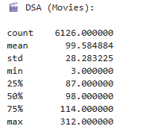
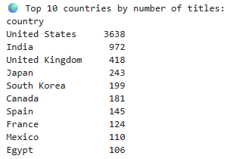
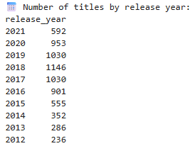
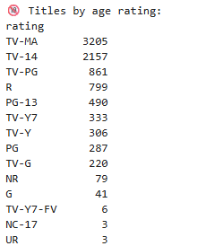

Descriptive statistical analysis

Slide 9
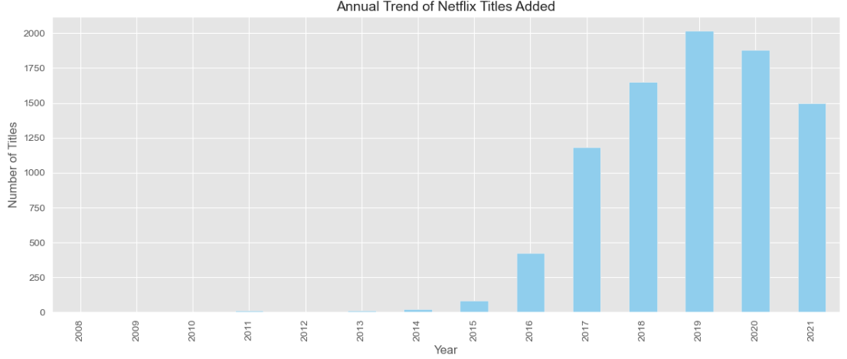
TRENDS analysis

Slide 10
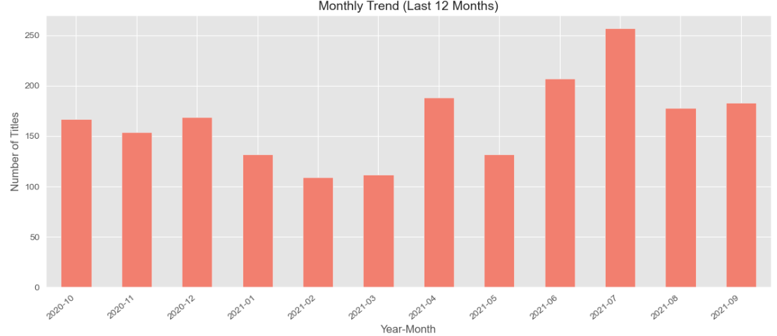
TRENDS analysis

Slide 11
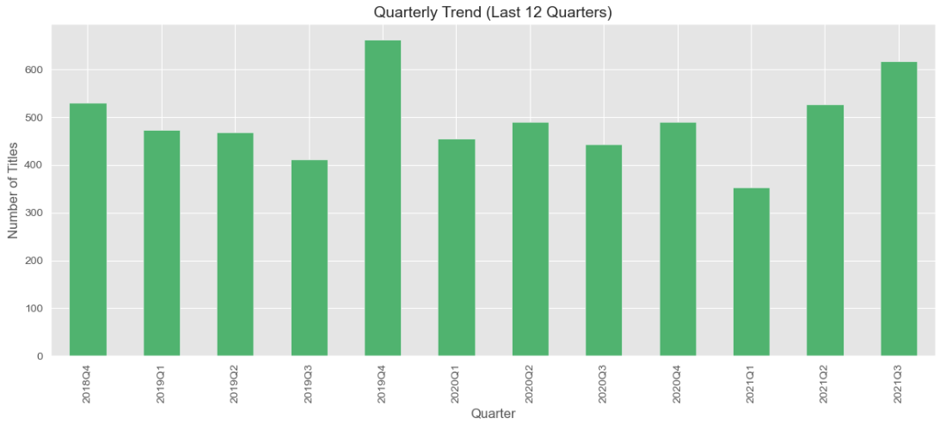
TRENDS analysis

Slide 12
Assumption and Questions
What is the distribution of Movies versus TV Shows in the Netflix dataset?
Which are the top 10 countries producing the most content on Netflix?
What is the distribution of content ratings on Netflix?
In Which Month Does Most of The Content Added To Platform?
How many content is international?
What is the distribution of movie durations on Netflix?
Dynamics of adding content to Netflix by all countries
What is the distribution of TV shows duration on Netflix?
What is the most released genres of content on Netflix?
Top 10 producers is…

Slide 13

Insights

Slide 14
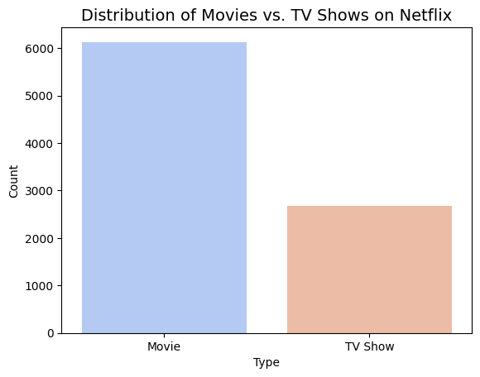
1 What is the distribution of Movies versus TV Shows in the Netflix dataset?

Slide 15
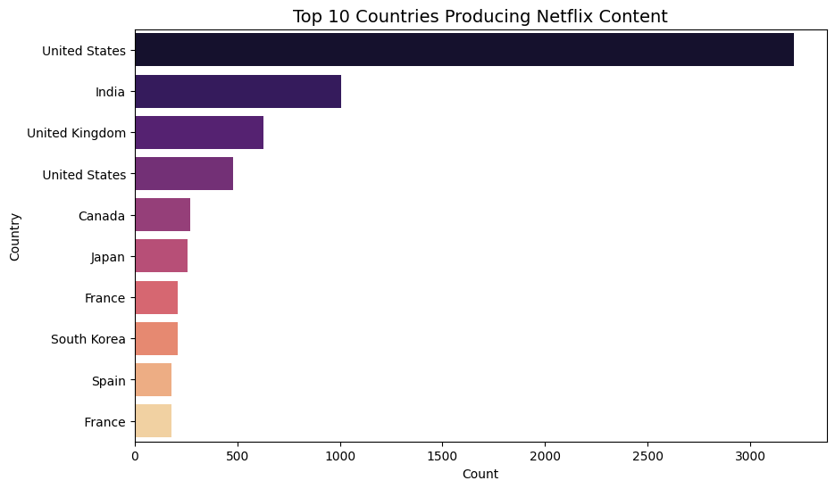
2 Which are the top 10 countries producing the most content on Netflix?

Slide 16
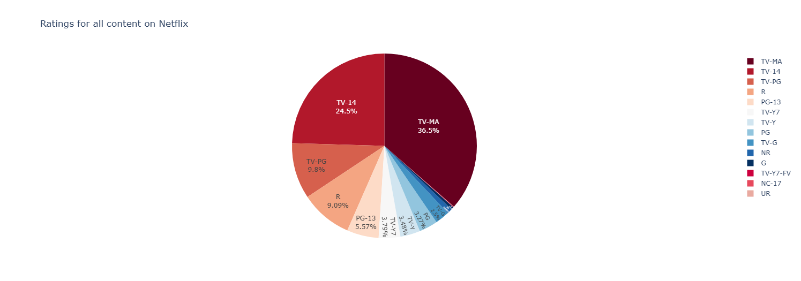
3 What is the distribution of content ratings on Netflix?

Slide 17

3

Slide 18
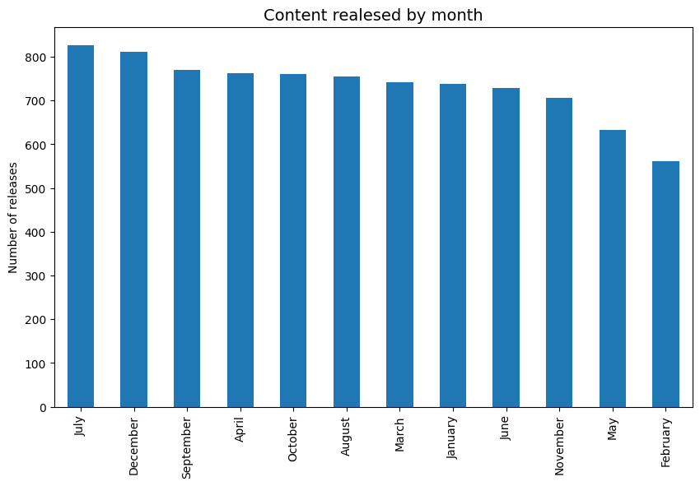
4 In Which Month Does Most of The Content Added To Platform?

Slide 19
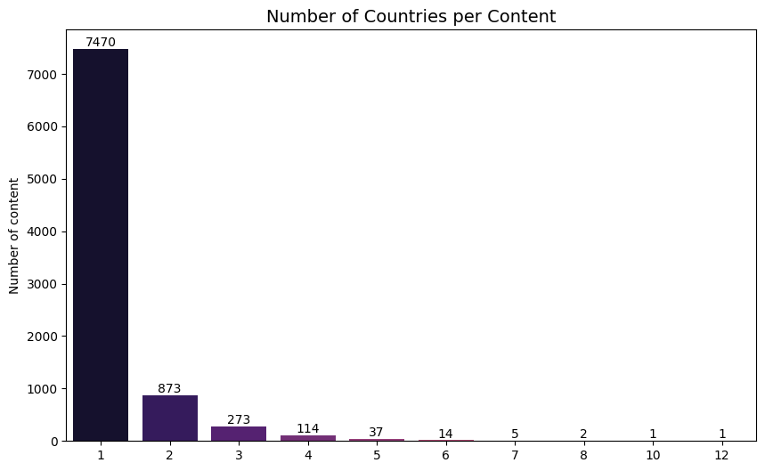
5 How many content is international?

Slide 20
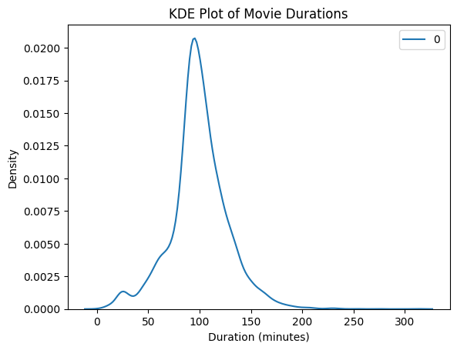
6 What is the distribution of movie durations on Netflix?

Slide 21
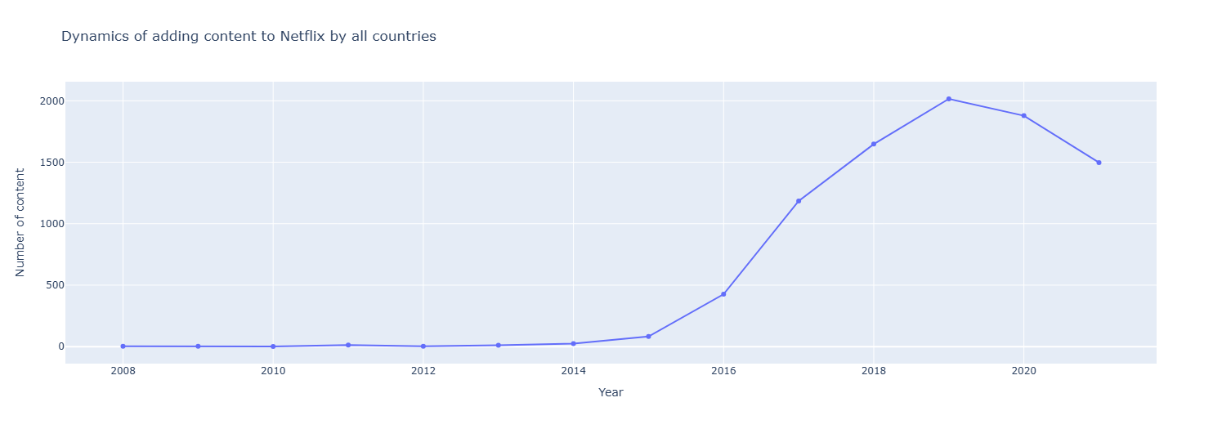
7 Dynamics of adding content to Netflix by all countries

Slide 22
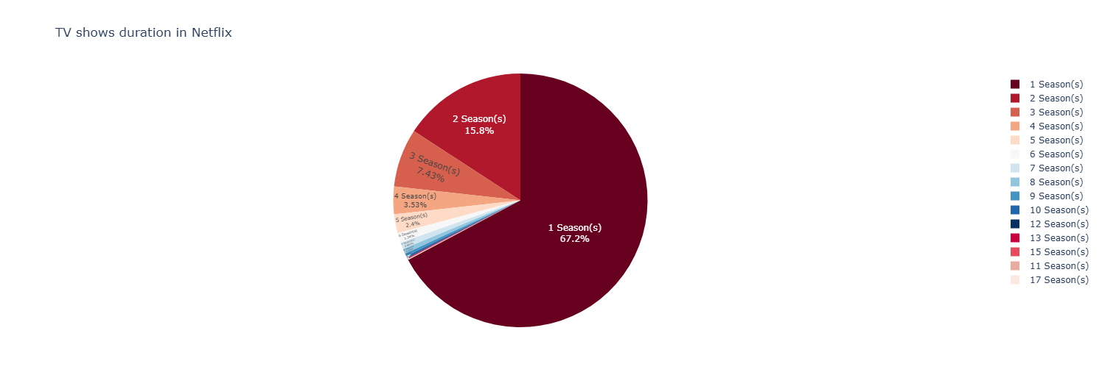
8 What is the distribution of TV shows duration on Netflix?

Slide 23
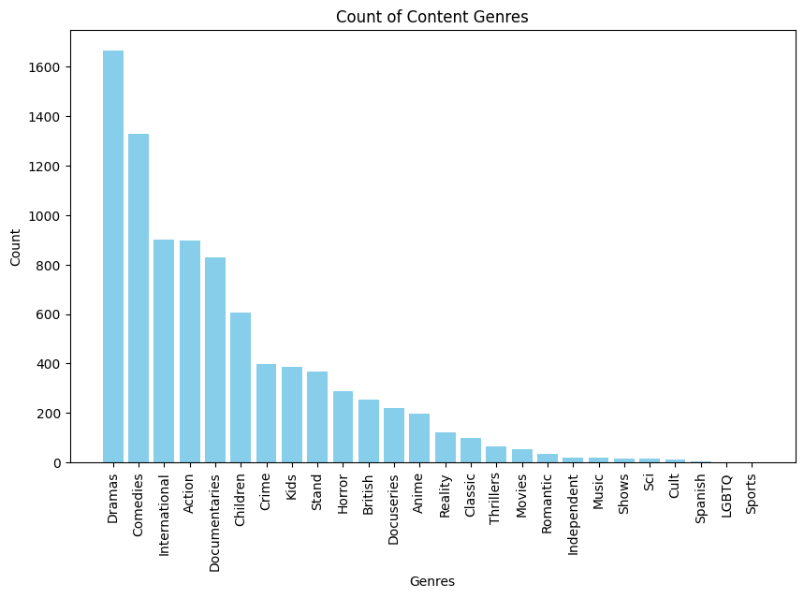
9 What is the most released genres of content on Netflix?

Slide 24
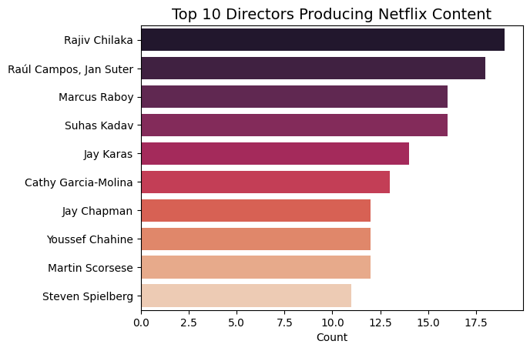
10 Top 10 producers

Slide 25
Summary and conclusions

Slide 26
We have seen from the data that most movies are 99 minutes long.
Movies make up almost 70% of the sample.
The US is the leading country in content production on Netflix.
In 2017, 2018, and 2019, the most content was released on Netflix, and then a decline in content releases began (perhaps new players entered the field).
Most content on Netflix is ​​intended for adults and young people (children only receive 23.4%)
July is the month with the most content released to the platform.
Most series end after only one season
Drama series are the most popular

Slide 27
Q&A

Slide 28

Thank you

